Slide 1
A method to mitigate the Code-Reuse Attacks
Advisor – Prof. R C Hansdah
Niranjan Singh
Sr. No. 11170

Slide 2
Buffer Overflow
Applications use call Stack.
Structure of call Stack shown below

Slide 3
Consider a small C language subroutine with one local variable buffer[12].
strcpy() used to fill it.
Does not check bounds and overwrites other locations.
Shellcode placed at location 0x80484cd.
Input be "A"*12 +"A"*4 +“\xcd\x84\x04\x08”
First 12 fills buffer[12]
Next 4 ovewrites frame pointer
Next 4 overwrites return address
Now function would return to injected code at 0x80484cd.

Slide 4
Stack after injection looks like-

Slide 5
prevented by Data execution prevention(DEP) technique.
marks stack and heap segments as non-executable.
used in almost every modern OS.
Stack canary technique proposed, but shown to be bypassed.

Slide 6
Code-Reuse Attacks
Does not inject new code
Uses code present in applications address space.
Shown to be Turing-complete.
Overwrite code pointers to direct control flow to attacker payload.
Payload consists of series of return address pointing to gadgets.
Gadgets - atomic operations like ADD, LOAD, etc. ending at a "ret" instruction.
E.g. mov %edx, %eax; ret
Mostly include-
Return-to-libc -> directs to code in libc
Return oriented programming -> uses gadgets ending with “ret”.
Jump oriented programming -> uses gadgets ending with “jmp”.

Slide 7
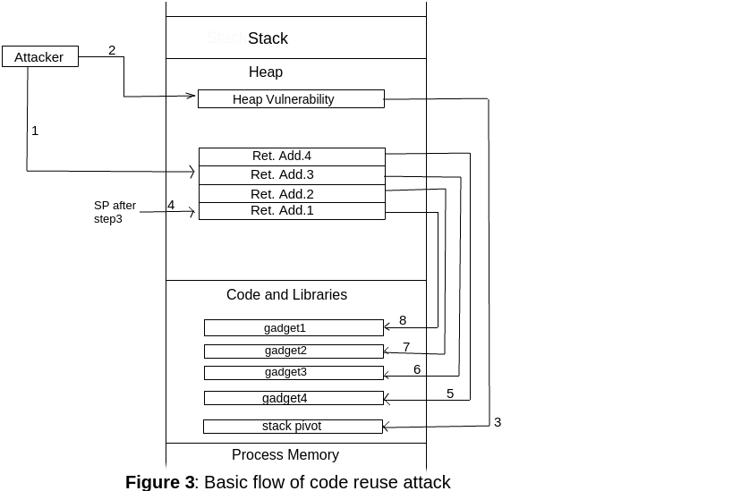

Slide 8
Basic Mitigation Techniques
Control-flow Integrity
Address Space Layout Randomization

Slide 9
Control-flow Integrity
creates a control flow graph of the application before execution.
Each node represents a basic block
runtime behavior of application is monitored to ensure that a valid path is followed by the control flow in CFG.
Uses shadow stack, store return address and compares them with original stack when returns.
Overhead of 21%.
Coarse-grained solutions-
return address should point to an instruction directly after a call instruction.
monitor the number of instruction executed between consecutive branches.
Shown to be bypassed.

Slide 10
Address Space Layout Randomization
randomize the base address of all the process areas like text, data, bss, libraries, etc.
prevented the return-to-libc attacks.
Used by almost all modern OS.
Bypassed by brute-force on 32-bit systems.
vulnerable to memory discloser attacks i.e., a single pointer leak may lead to the failure of whole ASLR.
ASLR on 64-bit with fine-grained randomization proposed
Randomization done even at basic block level.
Bypassed on Linux using offset2lib vulnerability.
Methods like ASLR-Guard proposed to prevent ASLR.

Slide 11
Advanced Offensive and Defensive Techniques
Just-In-Time Code Reuse
Uses the single leaked code pointer to get address layout of application recursively at runtime.
HAFIX: Hardware-Assisted Flow Integrity Extension
hardware based Backward-edge CFI approach.
a return is allowed to only target a call preceded instruction in a function that is currently active.

Slide 12
Proposed Method
Idea is to prevent the discovery of stack pivot gadget.
stack pivot gadget
modifies stack pointer to point it to attacker payload.
E.g. xchg %esp, %eax; ret
After loading application, search for stack pivot gadgets.
Store in table and encrypt them.
Replace their location in code by a pointer to the table.
Do decryption only for valid functions.

Slide 13
Conclusions and Future Work
Code-reuse attacks are one of the most prominent security exploits present.
No single approach is a silver bullet in defending these.
In future we intend to implement our approach against code-reuse attacks.
Will focus on security of encryption key.
Consideration on performance of decryption.

Slide 14
References
Aleph One. Smashing the stack for fun and profit. Phrack magazine, 7(49):14-16, 1996.
PaX Team. Pax address space layout randomization (aslr), 2003.
Kevin Z Snow et al. Just-in-time code reuse: On the eectiveness of ne-grained address space layout randomization. In Security and Privacy (SP), 2013 IEEE Symposium on, pages 574-588. IEEE, 2013.
M L Davi et al. Haxfix: Hardware-assisted flow integrity extension. 2015.
Ahmad-Reza S et al. Securing legacy software against real world code-reuse exploits: Utopia, alchemy, or possible future? In Proceedings of the 10th ACM Symposium on Information, Computer and Communications Security, pages 55-61. ACM, 2015.

Slide 15
Thank You….

